Slide 1

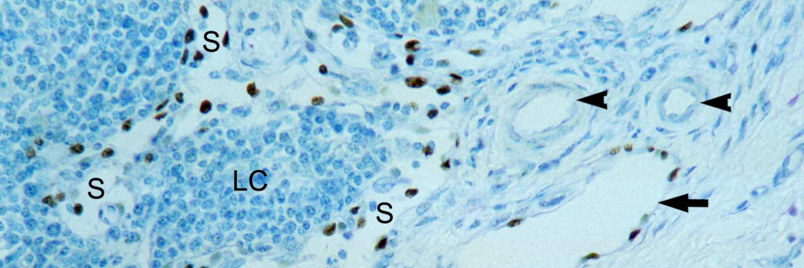
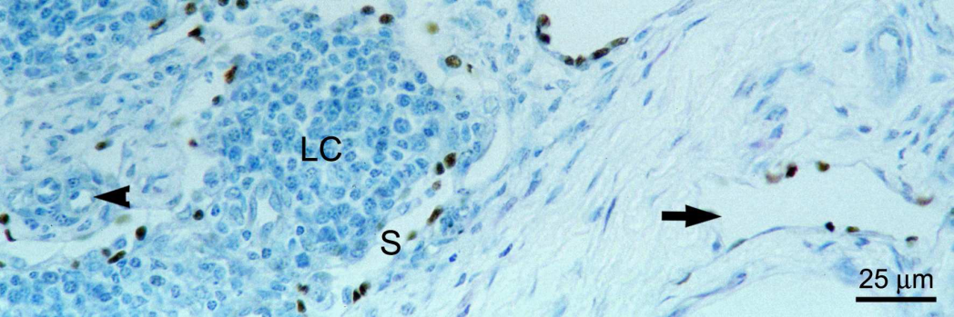
ReliaTech GmbH
Cross reaction of anti-human Prox-1 with
horse tissue sections
(ReliaTech: #102-PA32AG)
Equine mandibular lymph node, paraffin section, stained for Prox1 (rabbit, anti-human; ReliaTech Cat# 102-PA32AG), counterstained with toluidine blue.
Sinusoids (S) as well as lymphatic vessels in the hilum of the lymph node (arrows) are lined by positively stained lymphatic endothelial cells. Blood vascular endothelium remains unstained (arrow heads). LC: Cluster of lymphocytes
from: Staszyk, C., K. F. Duesterdieck, H. Gasse u. A. Bienert, Immunohistochemical identification of lymphatic vessels in the periodontium of equine cheek teeth. J. Vet. Dent. 22, 227 – 232, 2005
http://www.reliatech.de / orders@reliatech.de

